Slide 1
Funders and Funding Panels. Some thoughts…..
Jane Taylor.

Slide 2
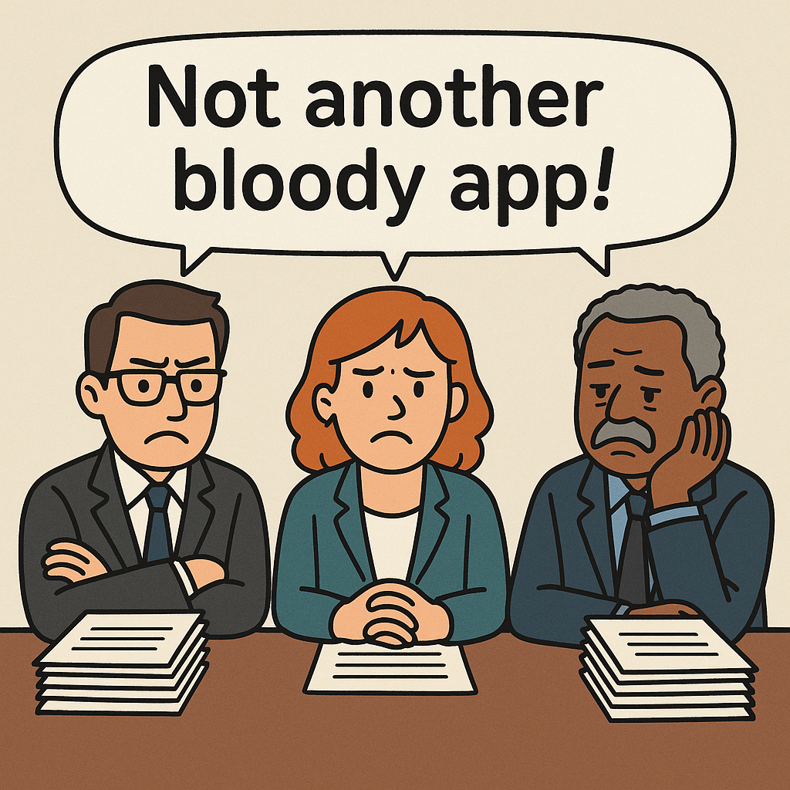

Slide 3
Funding panel: PPI evaluation
What will the impact of this be for patients/carers, directly or indirectly?
Is there evidence that this application fills an unmet need?
Is the PPI section appropriate and realistic for the size and type of project?
Is there clear evidence of having involved patients/carers/ public members in the shaping of the research and writing the bid? Has the researcher shown how their proposal changed as a result of this?
Has the researcher shown how patients/carers will be involved in steering /implementing the research?
Does the PPI budget accurately reflect the PPI activities? Is there evidence the researchers have done costings?
Often PPI budget requests don’t match the cost of the activities- - most are too low.

Slide 4
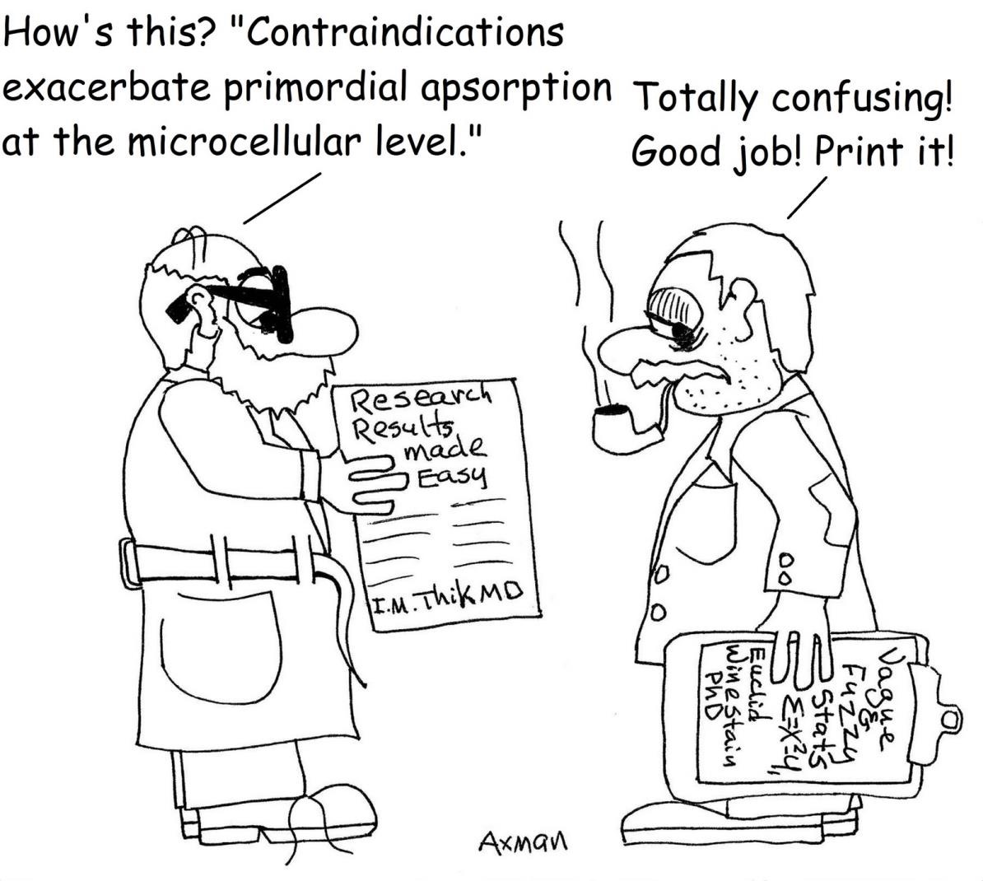
The Importance of Inclusive Language. Avoid unnecessary jargon and undefined acronyms. Make sure your language reflects current Equity, Diversity and Inclusion Practice. Proofread carefully.

Slide 5
Funding panel: Your response to reviewers
DO be respectful and polite whatever your private thoughts……
DO answer ALL questions raised by ALL reviewers with equal care and consideration
DO structure your responses in a clear and systematic way.
Where appropriate, you can use a reference to peer reviewed publications to provide background/ clarification.
DO NOT argue that the strengths of other aspects of the proposal outweigh some of the weaknesses identified by the reviewers.

Slide 6
Communicating your proposal to a funding committee.
Create the narrative of your research – tell a story.
What is the research idea?
What is the background?
Who will benefit?
Why is it needed? (Very important)
Why now?
How will your research make a difference? Where will it take you, the patients and research in the future?

